Slide 1
개원의 연수강좌 Neuropathic pain
노원을지대학교 병원
신경과 유일한

Slide 2
Epidemiology

Slide 3
Painful neuropathies
Diabetic polyneuropathy
Monoclonal gammopathy–associated polyneuropathy
Chemotherapy-induced polyneuropathy (associated with taxanes, oxaliplatin, vincristine, thalidomide, bortezomib)
Idiopathic small fiber polyneuropathy
Neuropathy associated with metabolic syndrome
Human immunodeficiency virus (HIV)–associated polyneuropathy
Hereditary sensory and autonomic neuropathies
Sjögren syndrome–associated polyneuropathy
Pyridoxine (vitamin B6) toxicity
Celiac neuropathy
Alcohol and other toxic neuropathies
Light chain and hereditary amyloidotic neuropathies
Nutritional deficiency neuropathies

Slide 4
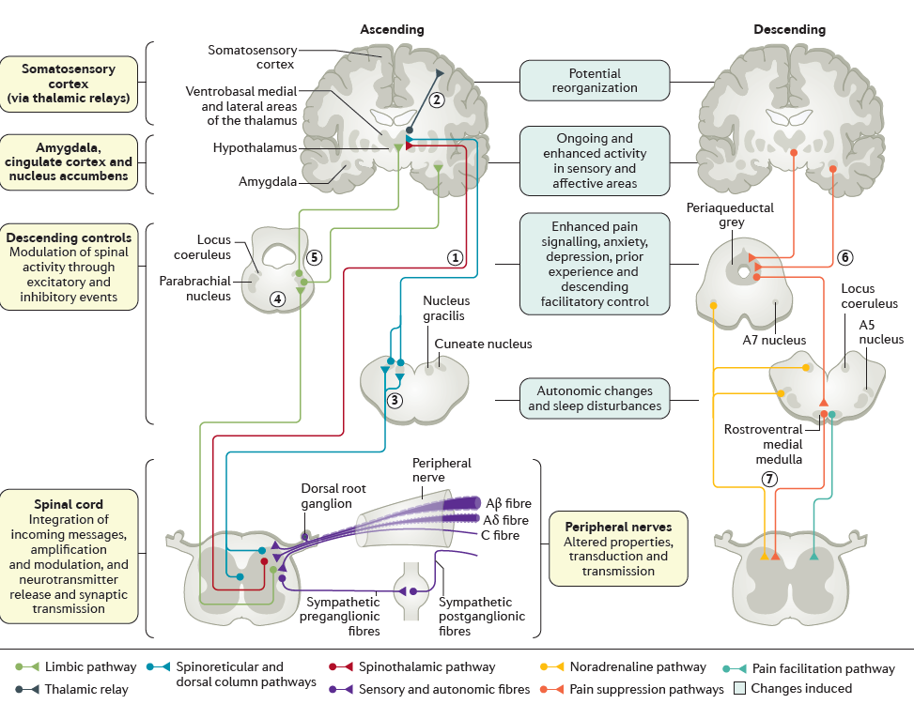
Luana Colloca et al., 2017

Slide 5
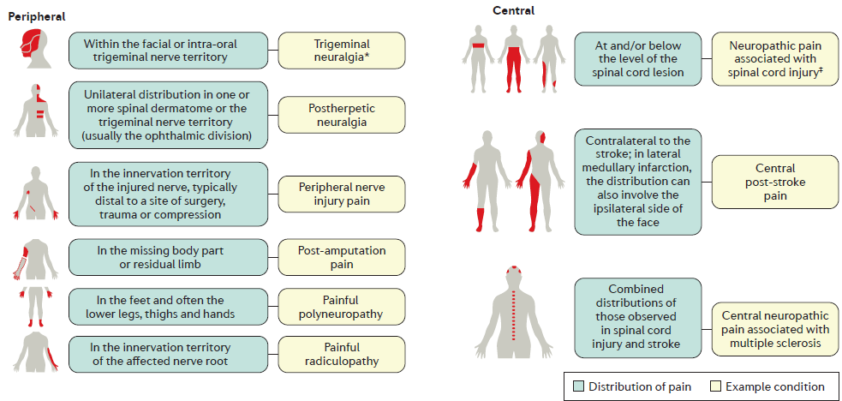
Luana Colloca et al., 2017

Slide 6
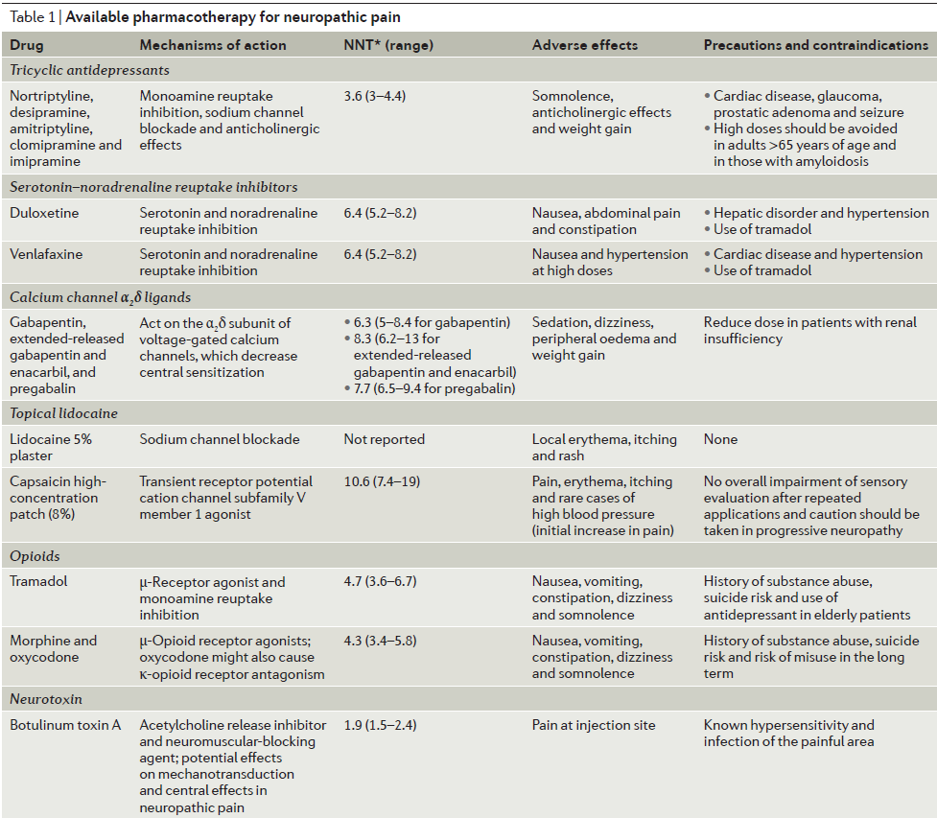
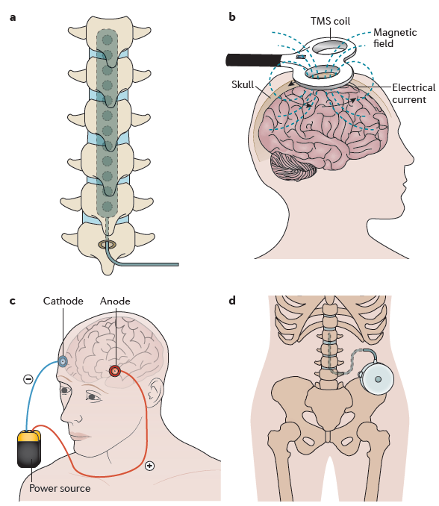
Luana Colloca et al., 2017
Notes:
a | Spinal cord stimulation traditionally applies a monophasic square-wave pulse (at a frequency in the 30–100 Hz range) that results in paraesthesia in the painful region. b | Cortical stimulation involves the stimulation of the pre-central motor cortex below the motor threshold using either invasive epidural or transcranial non-invasive techniques (such as repetitive transcranial magnetic stimulation (TMS) and transcranial direct current stimulation). c | Deep brain stimulation uses high-frequency chronic intracranial stimulation of the internal capsule, various nuclei in the sensory thalamus, periaqueductal and periventricular grey, motor cortex, septum, nucleus accumbens, posterior hypothalamus and anterior cingulate cortex as potential brain targets for pain control. d | Intrathecal treatments provide a targeted drug delivery option in patients with severe and otherwise refractory chronic pain. The pumps can be refilled through an opening at the skin surface.

